Slide 1
Changes in Per Capita Energy Use 1965-2021
Extracted from the country by country data base at
Our World In Data
Note: on a global scale the increase is 62% per citizen over this time period. But there are tremendous variations around this global average

Slide 2
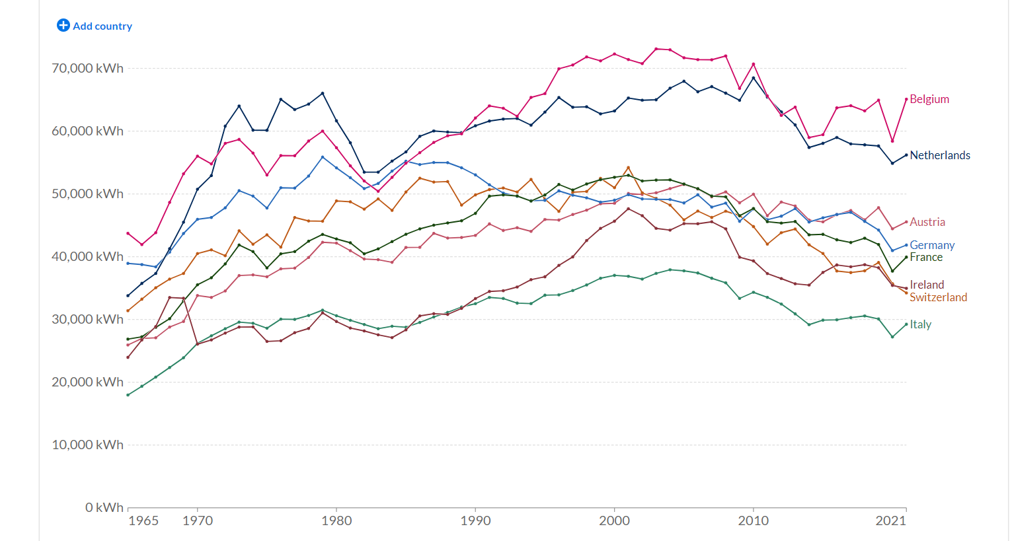
Western Europe

Slide 3
EASTERN Europe

Slide 4
Central America

Slide 5
BY continent

Slide 6
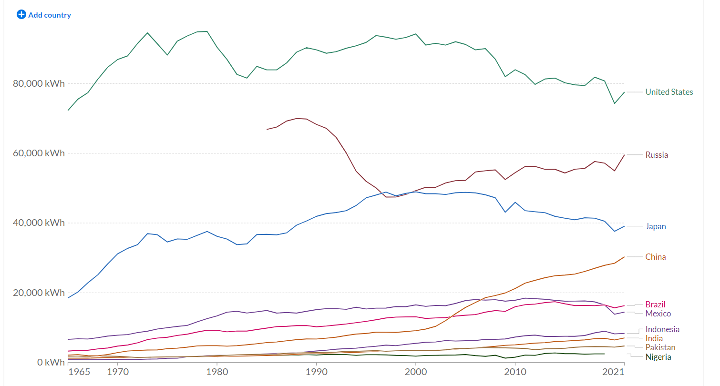
10 Biggest Countries

