Slide 1
Global Trends in Renewable Energy Deployment

Slide 2
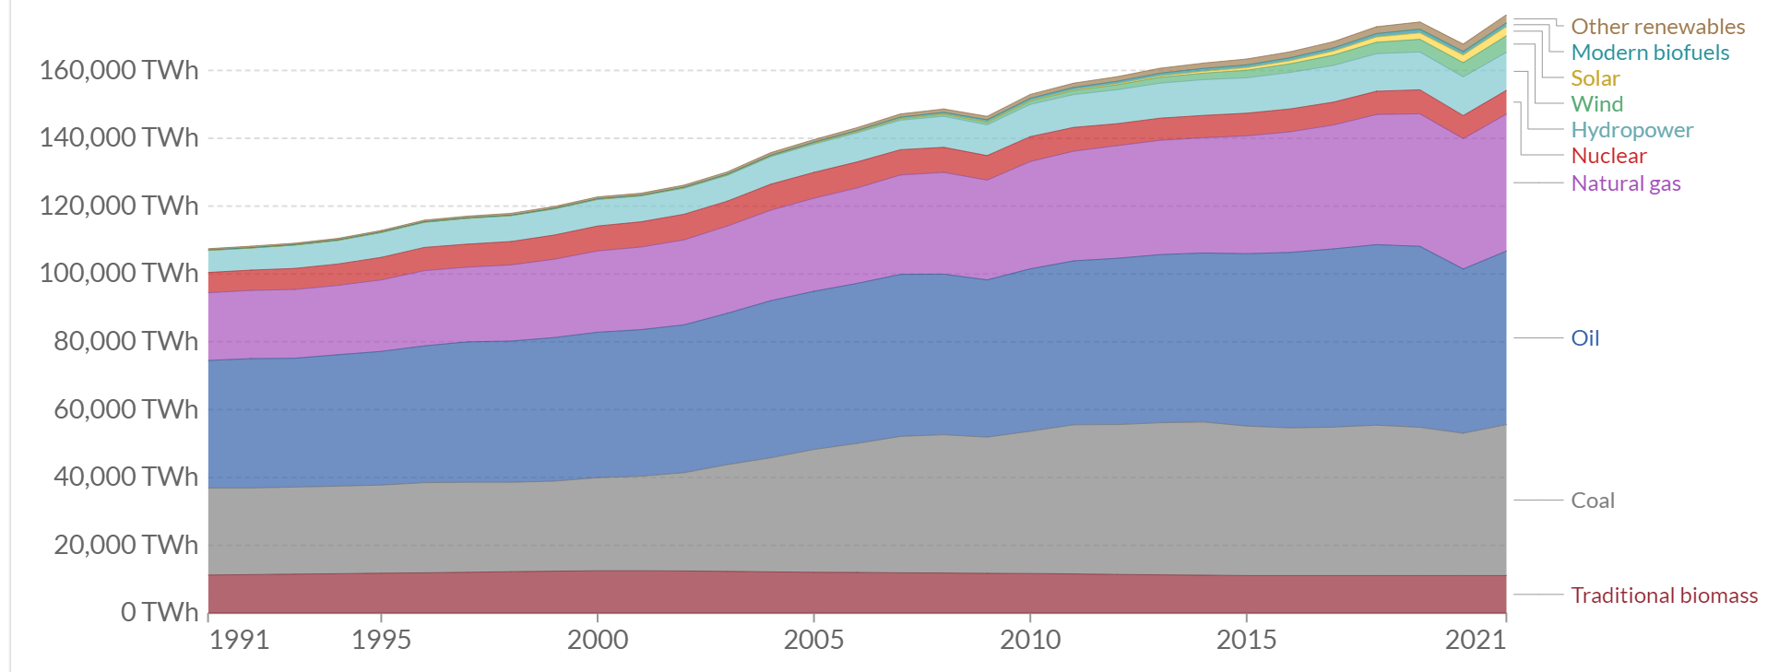
2021 Global Mix
Oil = 29%; Coal = 25% NG = 23%
Hydro = 6.3%; Nuclear = 4%
Wind = 2.7%
Solar = 1.5%
Biomass = 6.3%
1991 Global Mix:
Oil = 35%; Coal = 24%; NG = 18.6%
Hydro = 6.0%
Nuclear = 5.5%
Biomass = 10.5%

Slide 3
Some Notes
1. Nuclear is almost exclusively used to generate electricity (20-25 % in US and Europe) so its percentage contribution to energy is correspondingly smaller.
2. From 1991-2021 total energy use in the world grew by 64%; population grew by 46% ; hence per capita energy use is increasing

Slide 4
Renewables Growth over last 10 years (2011-2021)
Wind growth is 4x in this period but still now is only at 2.7 % of the world
4x is 2 doubling times in 10 years so wind doubles every 5 years
In the US wind was doubling about every 3 years
Solar is 15x – but easy to get rapid growth rates when you start from very little. 2011 = 181 TWH; 2021 = 2702 → but wind is still only 1.5% contribution
Hydro has grown only by 16%

Slide 5
Country Comparisons (1980)

Slide 6
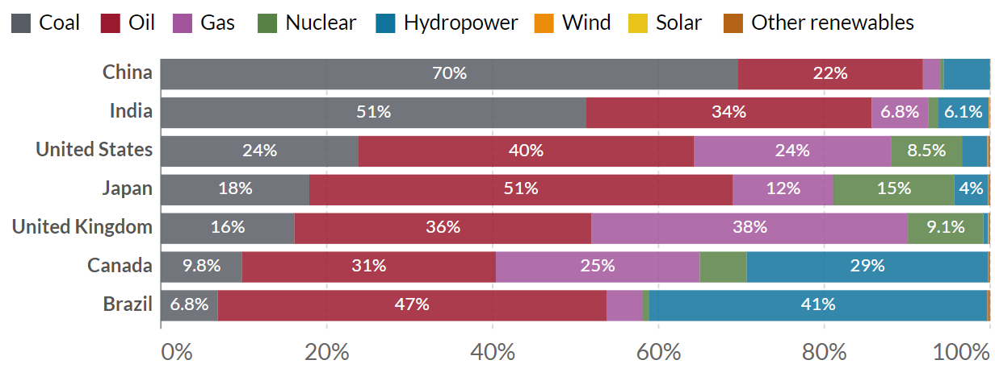
Country Comparisons (2000)

Slide 7
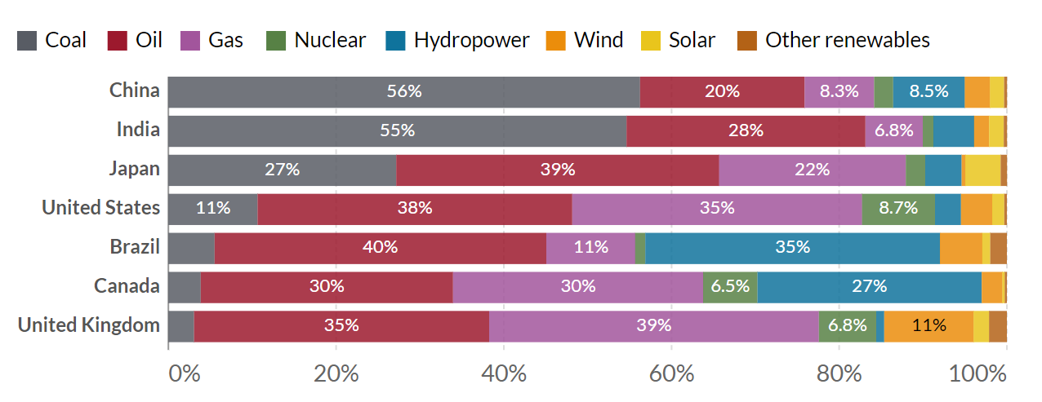
Country Comparisons (2020)

Slide 8
Comparing Trends: significant changes in green
 | Oil (80)** | Oil (00) | Oil (20) | Coal (80) | Coal (00) | Coal (20)
USA | 46% | 40% | 38% | 21% | 24% | 11%
China | 20% | 22% | 20% | 73% | 70% | 56%
India | 31% | 34% | 28% | 54% | 51% | 55%
USSR+ | 37% | 20% | 22% | 29% | 17% | 11%
Japan | 67% | 51% | 39% | 16% | 18% | 27%**
UK | 41% | 36% | 33% | 35% | 16% | 3%
Germany | 42% | 39% | 36% | 29% | 25% | 15%
** Japan increase due to Fukishima shutdown
** Oil is mostly for transportation so little change

Slide 9
Comparing Trends: Clear trajectory involving more NG more NUC
 | NG (80) | NG (00) | NG (20) | Nuc (80) | Nuc (00) | Nuc (20)
USA | 26% | 24% |  | 4% | 8%
China | 3% | 2% |  | ---- | 0.5%
India | 1% | 7% |  | 1% | 51%
USSR+ | 28% | 50% |  | 1.5% | 5%
Japan | 6% | 12% |  | 6% | 14%
UK | 20% | 38% |  | 4.5% | 9%
Germany | 14% | 21% |  | 4% | 12%

Slide 10
Comparing Trends:
 | NG (80) | NG (00) | NG (20) | Nuc (80) | Nuc (00) | Nuc (20)
USA | 26% | 24% | 35% | 4% | 8% | 8.7%
China | 3% | 2% | 8% | ---- | 0.5% | 2%
India | 1% | 7% | 7% | 1% | 1% | 1%
USSR+ | 28% | 50% | 53% | 1.5% | 5% | 7%
Japan | 6% | 12% | 22% | 6% | 14% | 2%**
UK | 20% | 38% | 39% | 4.5% | 9% | 6.8%
Germany | 14% | 21% | 26% | 4% | 12% | 5%

Slide 11
Comparing Trends: Hydro and Bio are oldest forms of energy generations
 | Hydro (80) | Hydro (00) | Hydro (20) | Bio (80) | Bio (00) | Bio (20)
USA | 4% | 3% | 3% | .1% | .25% | .31%
China | 4% | 5.5% | 8.5% | 0 | .02% | .33%
India | 13.5% | 6%** | 4.8% | 0 | .05% | .37%
USSR+ | 4% | 6.7% | 7% | ---- | --- | ---
Japan | 6% | 4% | 4.3% | .03% | .26% | .74%
UK | .5% | .5% | 1% | 0 | .15% | 2.1%
Germany | 1.3% | 1.8% | 1.5% | .05% | .09% | 1.6%
** no further investments made

Slide 12
Comparing Trends:
 | Wind (80) | Wind (00) | Wind (20) | Solar (80) | Solar (00) | Solar (20)
USA |  | .7% | 3.7% |  | 0 | 1.4%
China |  | 0 | 3% |  | 0 | 1.7%
India |  | 0 | 1.7% |  | 0 | 1.7%
USSR+ |  | 0 | --- |  | 0 | ---
Japan |  | 0 | 0.5% |  | .02% | 4.5%
UK |  | .1% | 11% |  | 0 | 2%**
Germany |  | .7% | 11% |  | 0 | 4%
** UK has very LOW solar resource

