Slide 1
Wind Energy USA

Slide 2
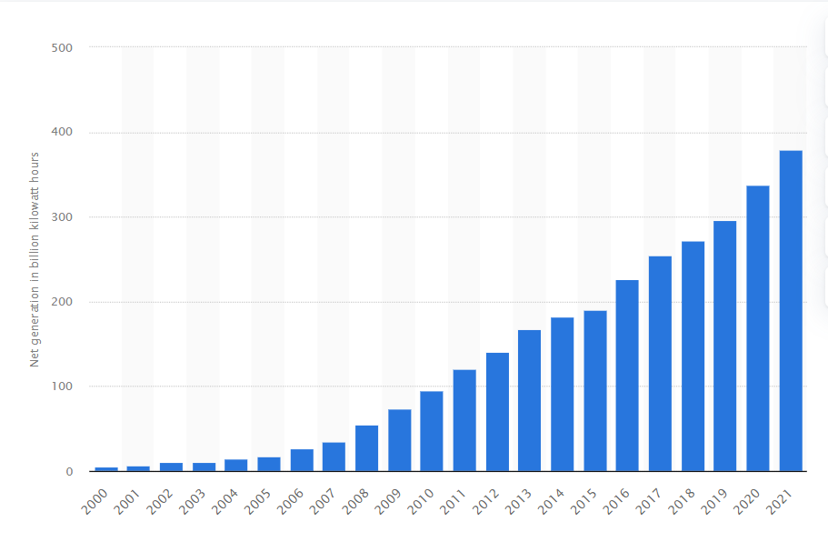
US Cumulative Wind Capacity since 2000

Slide 3
Annual Additions – Production Tax Credit Instability

