Slide 1
Power, Energy, Units, Infrastructure
A practical guide

Slide 2
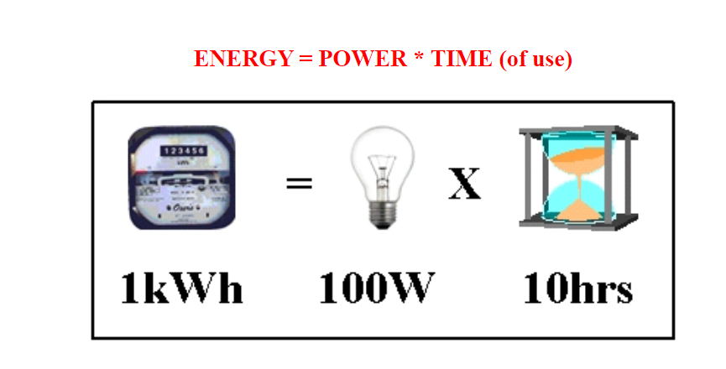
Watts:
1000 Watts = 1 Kilowatt
1000 Kilowatts = 1 Megawatt (MW)
1000 Megawatts = 1 Gigawatt (GW)
1000 Gigawatts = 1 Terawatt (TW)
1 TW = 1 million Megawatts
If we use our 100 watt light bulb for 1 hour we have used the equivalent of 100 watts * 1 hour = 100 watt hours of ENERGY. For residential, commercial and industrial energy use, the standard metered rate used by all electrical utilities in the US is the Kilo Watt Hour (KWH)
If we use our 100 Watt light bulb for 10 hours then that is 100 watts x 10 hours = 1000 watt hours = 1KWH. Your electricity rate is charge at some number of cents per KWH.

Slide 3
An Example of Scale
Total US NET electricity consumption in the year 2013 was approximately 4000 Terawatt Hours (TWH). We don't want to do these kinds of problems in energy units, but rather in power units.
There are 365 x 24 = 8760 hours per year.
So the NET electrical power requirements for the US are:
4000 TW hours/8760 hours = 0.457 TW or 457,000 Megawatts. However, integrated over all sources of power generation, we are about 50% efficient meaning that 914,000 Megawatts (0.91 TW) of power infrastructure was actually needed in order to produce 457,000 Megawatts of consumed electrical power. Hence, efficiency matters for power infrastructure

Slide 4
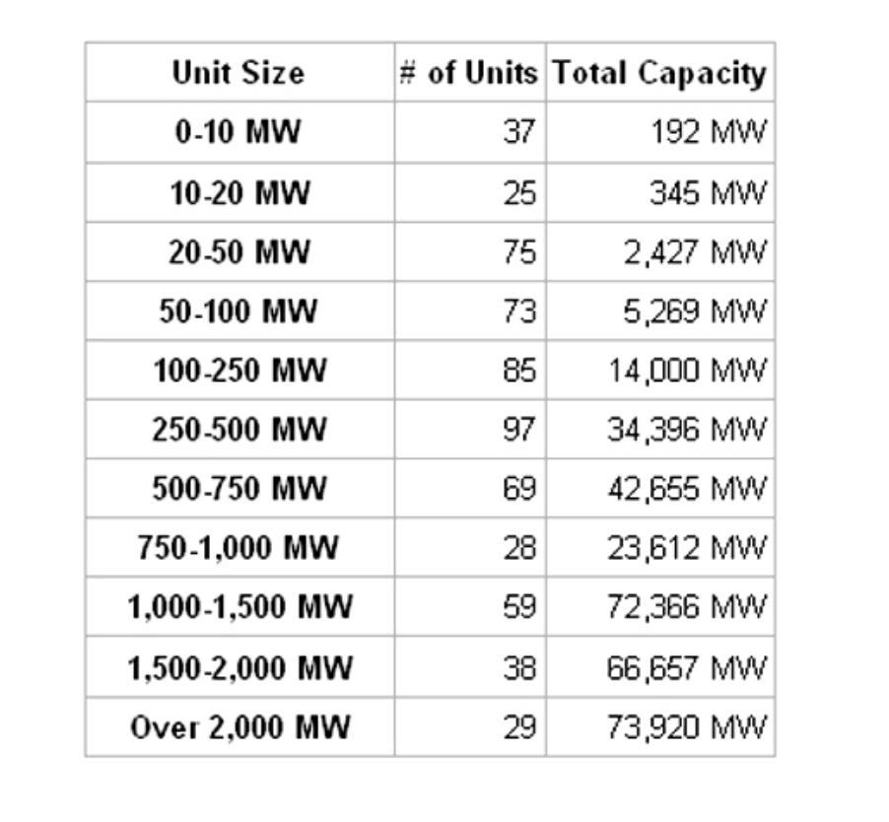
Averaged over the entire United States, the typical power plant size for the generation of electricity is 300 MW (tho individually this ranges from 1 MW to 6000 MW). An example of the large range of individual power plant capacities can be seen in the table for coal power generating infrastructure in the US.

Slide 5
Distribution of Power Plants in the US:

Slide 6
Power Plant/grid issues
If the average size per plant is 300 MW and we need 914000 MW of production then this requires about 3050 individual power plants that need to be hooked to the national grid for electricity production.
We are now annually losing about 10% of power plant generated electricity in our aging grid system or the equivalent of 300 power plants.
Clearly as our demand for electricity grows, we require more and more power plant construction. It is most cost effective to build a few large scale plants, rather than many smaller ones, due to grid limitations.

Slide 7
State Differences in Metered Electricity Rate
2007

Slide 8
2016

Slide 9
2021 Snapshot

Slide 10
Some Notes:
There are no longer strong state to state variations in the cost of electricity as existed in the past (25 years ago or so)
Regionally, the Northeast Pays 1.5 times more than the national average so energy costs are a significant political and social concern there.
The Pacific Northwest no longer has a sole monopoly on cheap electricity. Some of this is related to long term climate change which is causing a significantly reduced snow pack and therefore reduced hydroelectricity as part of overall energy portfolio.
Electricity prices in the state of Texas (now cheaper than OR) have come down largely due to significant capacity additions in Wind. Traditionally, hydro has provided about 70% of Oregon electrical power. However, due to reduced stream flow in the Columbia River Basin, hydro now has fallen below 1/2 so Oregon needs to find other sources for power generation.

Slide 11
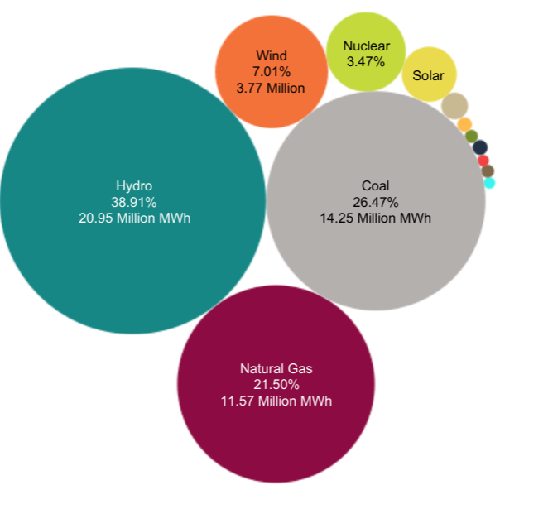
Oregon Electricity Mix: 2012 (left) 2020 (right)

