Slide 1
Wave Energy – Its potential and its real world limitations
Wave energy is not very scalable and is restricted to feasibility and just a few sites the world

Slide 2
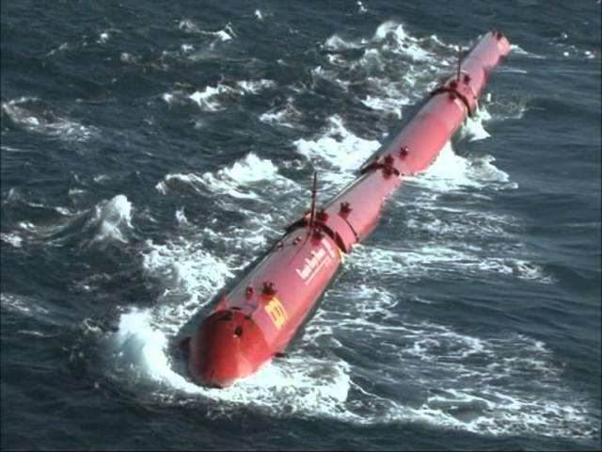
Wave energy, is a source of renewable energy that has not yet been exploited on any significant scale. While wave energy is highly variable hourly and seasonally it is continuous over 24 hours which gives it a principle advantage over wind and solar. Wave power which is incident on a shoreline is measured in units of KW per meter where the meters refer to the length of the wave front (50-100 meters)
The best sites are: The North Atlantic off the coast of Ireland - some experimental devices have been deployed there – best large scale location
The Gulf of Alaska - a difficult environment
The Cape of Good Hope - an extremely difficult environment
The SW coast of Australia off of Perth - this is very promising
Portugal - and devices have been deployed there.
The Washington and Oregon Coastlines are also decent

Slide 3
The power per meter in an ocean wave depends on only two physical parameters:
The square of the wave height (H or A)
The period of the waves (T) - the period is simply the wave frequency which is the number of waves per minute that strike your wave energy device
Thus, to maximize ocean wave energy you would build something that either maximum wave height or maximum frequency of both. The problem with maximum wave height is that the wave is more destructive and therefore the device has to be pretty damn sturdy. Wave frequency is generally determine by coastal topography and sites with high frequency are therefore good.

Slide 4
Hypothetical Example for Oregon Coast – what is the total yield?
The average wave power is 40 KW per meter
Total length of coastline is 600 km
Wave Energy Devices are 10% efficient
The total power yield is then 40 kw/m * 1000 m/km * 600 km = 24000 MW. Total electrical capacity in OR currently is about 17,500 MW → in Principle this is a solution. If OR wanted say 10% of its energy portfolio to come from waves then this requires 1750/40 ~45 KM of coastline

Slide 5
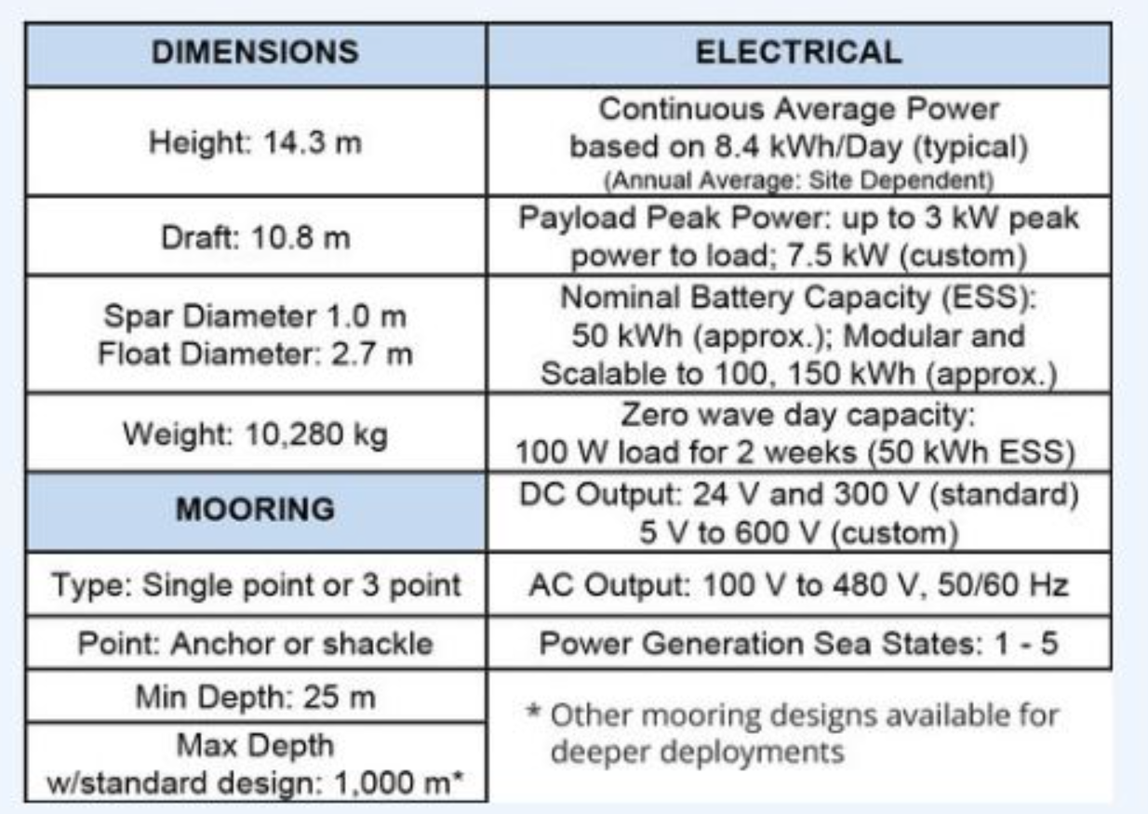
Ocean Power Technologies PB 3(KW) Power Buoy proposed project off coast from Reedsport
This project is ridiculous and eventually was cancelled but it was all the rage when first proposed circa 2010. Why ridiculous ??
10000 Kg/3 KW ~ 3000 kg/kw
The Reedsport project was meant to deploy 10 power buoys for a total project nameplate of 1.5 MW or 1.5/17500 of our Oregon's electricity generating portfolio. At such a small scale the project doesn't seem too sensible and if you scaled this up to provide 10% contribution this would require deploying 1250 Bouys @$2 (est) million each or $2.5 Billion!!

Slide 6
OPT also turned out to be an unreliable company (but they still exist)

Slide 7
In a wave, the energy content is continuously distributed through our the entire wave. This means that to capture the entire energy of the wave you need to build a device that is as long as the wave. To get around this situation you would have to build a device to focus, collimate or attenuate this distributed energy into a smaller area (just imagine a really big funnel).
In addition, there is the consideration of device placement. There are basically 3 choices a) off shore; b) near-shore; c) on the shoreline/coastline. When a wave is off shore it is basically a swell which is mostly vertical movement of the ocean surface. This is basically how the Power Buoy operates. The two problems with this location are a) swell energy is less than actual wave energy and b) grid connections off-shore are difficult and expensive. When the wave is near shore it is at its maximum height (amplitude) and energy. Such waves are often surfed upon and it would be an environmental disaster to deploy in that location. When the wave impacts the "shoreline" it is breaking and losing energy. However, this is off set by easy access to the shoreline thus lowering construction costs (but of course environmentally altering the shoreline).

